Slide 1
Analysis of XOR Function
Prove that the XOR is Non-Linear Function by Graphically and Mathematically
Name : - Jimita Gandhi

Slide 2
PROBLEM STATEMENT
single perceptron can’t represent the Boolean XOR function.
We can use a 2 layered network of perceptron's to learn the XOR function so the first layer can “ learn a different [linearly separable] feature space”.
Tis an operation on two binary he XOR function (“exclusive or”) values,x1andx2.
four points X={[0,0], [0,1],[1,0], and [1,1]}.

Slide 3
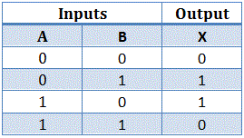
The XOr, or “exclusive or”, problem is a classic problem in ANN research. It is the problem of using a neural network to predict the outputs of XOr logic gates given two binary inputs. An XOr function should return a true value if the two inputs are not equal and a false value if they are equal. All possible inputs and predicted outputs are shown in fig.
four points X={[0,0], [0,1],[1,0], and [1,1]}.

Slide 4
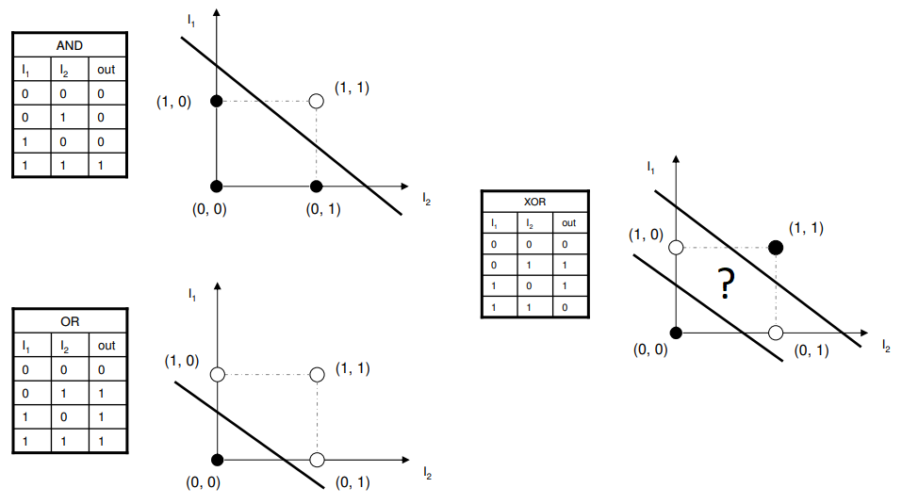
GRAPHICALLY REPRENTATION
As we can see , the graph of AND , OR Both have the linear graph but according to the XOR values we get the graph in an un-appropriate form that is Non-Linear graph.
Thus , we can conclude that after plotting the values from truth table in graph , it show that XOR is a Non-Linear function.

Slide 5
1.w1 + 0.w2 cause a fire, i.e. >= t
0.w1 + 1.w2 >= t
0.w1 + 0.w2 doesn't fire, i.e. < t
1.w1 + 1.w2 also doesn't fire, < t
w1 >= t
w2 >= t
0 < t
w1+w2 < t
Contradiction.
all 4 inequalities for the contradiction

Slide 6
SOLUTION
In order to solve the problem, we need to introduce a new layer into our neural networks. This layer, often called the 'hidden layer', allows the network to create and maintain internal representations of the input.

